Slide 1


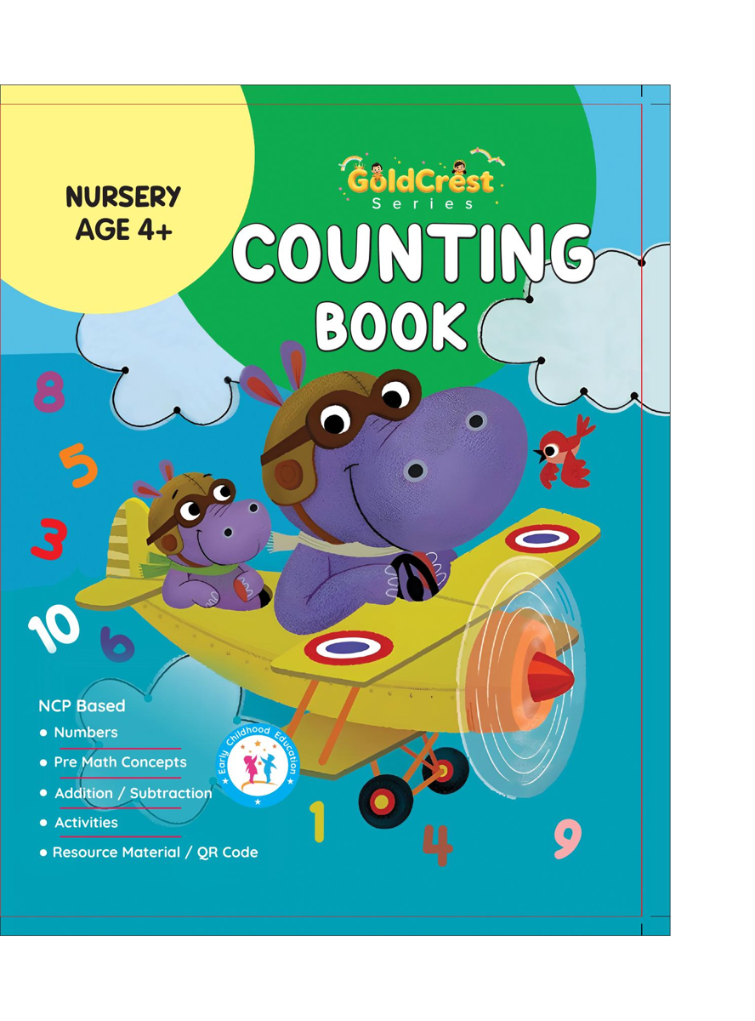
GoldCrest Counting Book
Nursery • Age 4+
An activity-based early-years book from the GoldCrest Series.
A Project of Azhar Publishers & Book Factory

Slide 2
i
What's Inside
GoldCrest Counting Book Nursery • Age 4+
1
Pre-writing lines and shapes
2
Numbers 0–50 and number words
3
Counting on and back; missing numbers
4
Telling o'clock time
5
2 and 3 times tables
6
Simple addition and subtraction

Slide 3
★
Purpose & Classroom Support
Builds number sense, counting and early arithmetic through colourful, hands-on activities.
“
Every book comes with
1
2
3
Teacher's Lesson Plan
Practice Papers
Digital Interactive Version
A 40-week lesson plan that guides teachers, day by day.
Monthly tests and term exam papers for children to attempt.
An interactive flipbook and digital exercises for engaging, screen-based practice.
A Project of Azhar Publishers & Book Factory

